Slide 1


Decred Project Update
Miami, US
January 16, 2019

Slide 2


Introduction
Jake Yocom-Piatt
Decred Project Lead
Company 0 CEO

Slide 3

Funding Overview

Slide 4
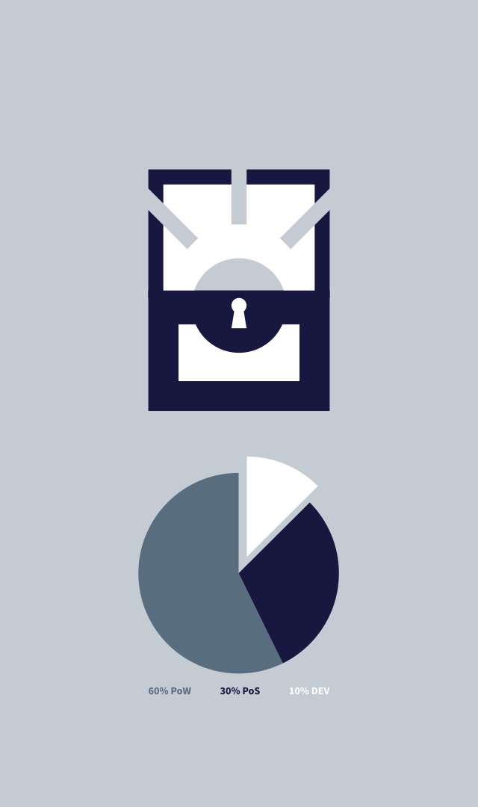

Project Funding Model
Launched with 8% (DCR 1.68M) premine split 50/50 between developers and an airdrop to 3,000 users
Decred sends 10% of each block reward to its treasury organization, Decred Holdings Group LLC
Treasury currently holds over DCR 600K

Slide 5
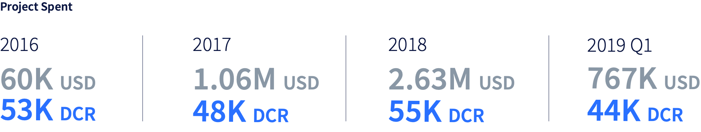
Treasury History
Core project development was funded by Company 0 LLC from Feburary 2016 until May 2017
The Treasury has spent less than it has taken in from its 10% subsidy every month since launch, except for the January 2019 payout

Slide 6
Treasury Management
The Treasury is currently managed by a centralized corporate entity
To decentralize treasury management, we developed and deployed Politeia, a time-ordered censorship-resistant filesystem where stakeholders can vote on proposals
A proposal has been made to decentralize the control of Treasury funds on Politeia

Slide 7
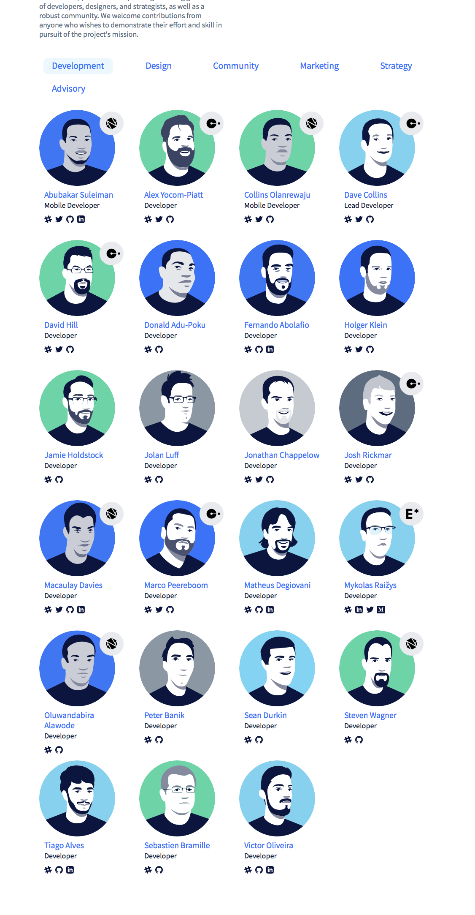
Treasury Snapshot
Current Treasury expenditure rate is roughly USD 250K / month
Unless there is a substantial sustained drop in the DCR/USD exchange rate, Decred can continue paying its contractors for decades
Contractor management tools, based on Politeia, are being developed to drive efficiency with contractors’ work product

Slide 8

Roadmap Overview

Slide 9
Roadmap Overview
Since releasing our first roadmap in January 2017, I have been making an active effort to get away from roadmaps
Our proposal system will eventually absorb the roadmap entirely, so that every planned subproject within Decred will be visible there

Slide 10



Major roadmap deliverable sets
Governance
Lightning Network
Privacy

Slide 11

Governance
Consensus rule changes have been subject to on-chain stakeholder voting since April 2017
Off-chain decisions regarding use of Treasury funds began in October 2018 on our proposal system, and the scope of the proposal system is continuing to expand
Off-chain management of contractors is being worked on currently
The final step of decentralizing control of Treasury funds has been proposed and should be implemented during 2019

Slide 12

Lightning Network
All consensus changes needed to support LN have been made and activated on mainnet
Lightning Labs’ lnd has been ported to Decred and has an initial release
Rough integration of lnd into our existing GUI wallet, Decrediton, is complete
Proper integration of LN into Decrediton will take several months

Slide 13

Privacy
Privacy features have been under development and will be revealed shortly
The approach will differ from that of existing privacy coins
The initial release will focus on on-chain privacy, but off-chain privacy plans will also be announced as part of the initial release

Slide 14

Decred: Secure. Adaptable. Self-Funding.
Questions?
Thanks!
January 16, 2019
Decred Team www.decred.org

